Slide 1


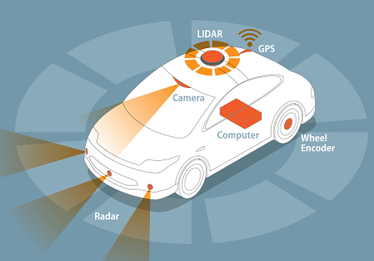
Autonomous Vehicle Object Recognition System: A Comprehensive Image Analysis Solution
Name of The Students: Shiva Sirasanagandla
(21CS002421)
Gaddam karthik Reddy
(21CS002374)
Hrishikesh Reddy
(21CS002382)

Slide 2
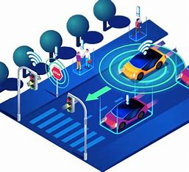
Introduction to Autonomous Vehicles Object Recognition System
Autonomous vehicles (AVs) are revolutionizing the transportation industry, offering the promise of safer, more efficient, and environmentally-friendly mobility solutions. At the heart of this revolution lies the autonomous vehicles object recognition system, a comprehensive image analysis solution that enables AVs to perceive and understand their surrounding environment with unprecedented accuracy and reliability.
This cutting-edge system combines advanced sensor technologies, including LiDAR, radar, and high-resolution cameras, to create a detailed 3D model of the vehicle's surroundings. Through sophisticated algorithms and machine learning techniques, the system is able to identify and classify a wide range of objects, from other vehicles and pedestrians to traffic signs and road hazards, in real-time. This information is then seamlessly integrated into the AV's decision-making process, allowing it to navigate safely and intelligently, even in complex, dynamic environments.

Slide 3
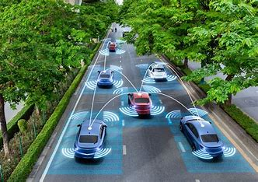
Comprehensive Image Analysis Solution
At the core of the autonomous vehicles object recognition system is a sophisticated image analysis framework that leverages state-of-the-art computer vision and deep learning techniques. This comprehensive solution ingests high-resolution data from a multitude of sensors, including LiDAR, radar, and advanced camera systems, to create a detailed, real-time 3D model of the vehicle's surroundings.
Through complex algorithms and neural networks, the system is able to identify and classify a wide array of objects with remarkable accuracy, from other cars and pedestrians to traffic signals, road signs, and potential hazards. By continuously analyzing this rich visual data, the autonomous vehicle can navigate safely and intelligently, making informed decisions to avoid obstacles, adhere to traffic laws, and ensure the safety of all road users.

Slide 4
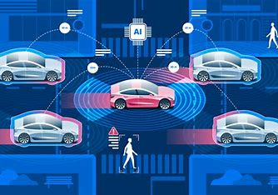
Sensor Modalities: LiDAR, Radar, and Camera
The autonomous vehicles object recognition system relies on a powerful triad of sensor technologies to create a comprehensive, real-time understanding of its surroundings: LiDAR, radar, and advanced camera systems. Each of these sensor modalities brings unique capabilities and strengths to the table, working in tandem to provide the AV with a multilayered, redundant perception of its environment.
LiDAR (Light Detection and Ranging) utilizes pulsed laser light to generate highly accurate, high-resolution 3D point cloud data, allowing the system to precisely map the vehicle's surroundings, including the shape, size, and location of objects. Radar (Radio Detection and Ranging), on the other hand, uses radio waves to detect the presence, speed, and direction of objects, providing critical information about the motion and trajectory of nearby vehicles, pedestrians, and other dynamic elements.
Complementing these active sensor technologies, the system also incorporates high-resolution camera systems that capture detailed visual imagery, enabling the use of advanced computer vision and deep learning algorithms to identify and classify a wide range of objects, from traffic signs and lane markings to pedestrians and cyclists. By fusing the data from these diverse sensor modalities, the autonomous vehicles object recognition system can build a comprehensive, redundant, and highly reliable understanding of its surroundings, enabling the AV to navigate safely and confidently in even the most complex environments.

Slide 5
Literature Review on Sensor Fusion
Techniques
The autonomous vehicles object recognition system relies on a robust sensor fusion framework to combine the disparate inputs from its LiDAR, radar, and camera systems. Extensive research has been conducted on various sensor fusion techniques, each with its own strengths and trade-offs. A thorough literature review reveals several promising approaches that have been successfully applied in the context of autonomous driving.
One prevalent method is the Kalman filter, a recursive algorithm that optimally estimates the state of a dynamic system by fusing measurements from multiple sensors. Extended Kalman filters, in particular, have demonstrated excellent performance in tracking the position, velocity, and acceleration of moving objects, making them a popular choice for autonomous vehicle perception. Other techniques, such as Bayesian fusion and Dempster-Shafer theory, offer alternative probabilistic frameworks for integrating sensor data and managing uncertainty.
More recently, the rise of deep learning has led to the development of sophisticated sensor fusion architectures that leverage the power of neural networks. These data-driven approaches can learn complex, nonlinear relationships between sensor inputs, allowing for more accurate object detection, classification, and tracking. Prominent examples include sensor fusion networks that combine visual, LiDAR, and radar data to create a comprehensive understanding of the vehicle's surroundings.
As the field of autonomous driving continues to evolve, researchers are exploring even more advanced sensor fusion techniques, such as those involving graph neural networks, attention mechanisms, and multi-modal sensor fusion. These cutting-edge methods aim to further enhance the robustness, accuracy, and reliability of the autonomous vehicles object recognition system, paving the way for safer and more intelligent self-driving technology.

Slide 6
Sensor Fusion Methodology and Purpose
The autonomous vehicles object recognition system employs a sophisticated sensor fusion methodology to seamlessly integrate the data from its LiDAR, radar, and camera sensors. This multifaceted approach serves a critical purpose in creating a comprehensive, redundant, and reliable understanding of the vehicle's surrounding environment.
Sensor Fusion Techniques
At the heart of the sensor fusion process are advanced algorithms and machine learning models that can effectively fuse the heterogeneous data from the various sensor modalities. This includes the use of techniques like Kalman filtering, Bayesian fusion, and deep neural networks, each of which offers unique strengths in terms of handling noisy, incomplete, or conflicting sensor inputs. By leveraging these powerful data fusion frameworks, the system can generate a unified, high-confidence representation of the vehicle's surroundings.
Redundancy and Robustness
One of the key purposes of the sensor fusion methodology is to create a redundant and robust perception system that can reliably detect and track objects in diverse driving conditions. By drawing on the complementary strengths of LiDAR, radar, and cameras, the system can cross-validate the data, filling in gaps and mitigating the limitations of any single sensor. This redundancy ensures that the autonomous vehicle maintains a comprehensive understanding of its environment, even in the face of sensor failures or adverse weather conditions.
Accurate Object Detection and Tracking
Leveraging the complementary strengths of the sensor suite, the sensor fusion methodology also aims to optimize the computational resources required to process and analyze the vast amounts of sensor data. By intelligently merging and filtering the inputs, the system can reduce the overall computational load, enabling faster processing and real-time decision-making, which is essential for the safe and responsive operation of autonomous vehicles.
Computational Efficiency
The ultimate purpose of the sensor fusion process is to enable the autonomous vehicles object recognition system to accurately detect, classify, and track a wide range of objects in the vehicle's vicinity. By fusing the high-resolution 3D data from LiDAR, the motion-sensing capabilities of radar, and the visual insights from cameras, the system can create a holistic representation of the vehicle's surroundings, including the position, velocity, and trajectory of other cars, pedestrians, and obstacles. This precise understanding of the driving environment is critical for the autonomous vehicle to make safe and informed decisions.

Slide 7
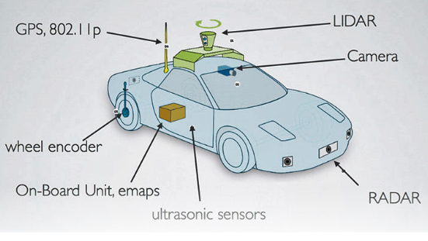
Extended Kalman Filter for Object Tracking
1
Modeling Object Motion
At the core of the extended Kalman filter (EKF) for autonomous vehicle object tracking is the ability to model the complex, dynamic motion of surrounding objects. The EKF leverages a state-space representation, where the state includes key variables like the object's position, velocity, and acceleration. By continuously updating this state based on sensor measurements, the filter can accurately predict the future state of the object, enabling the autonomous vehicle to anticipate its movement and plan safe trajectories.
2
Nonlinear Sensor Fusion
Unlike the standard Kalman filter, which is designed for linear systems, the extended Kalman filter can handle the nonlinear relationships between the object's state and the sensor measurements. This is crucial in the context of autonomous driving, where the sensor data, such as LiDAR point clouds and radar detections, exhibit complex, nonlinear dependencies on the object's state. The EKF addresses this by linearizing the measurement model around the current state estimate, allowing it to fuse the diverse sensor inputs and maintain a robust, accurate track of the object's motion.
3
Uncertainty Management
A key strength of the extended Kalman filter is its ability to explicitly model and manage the uncertainty associated with the object's state and the sensor measurements. By maintaining a covariance matrix that represents the uncertainty in the state estimate, the EKF can dynamically adjust the Kalman gain to weigh the sensor inputs based on their relative reliability. This uncertainty-aware approach enables the autonomous vehicle to make informed decisions, even in the face of noisy or incomplete sensor data, leading to more robust and safe navigation in complex environments.

Slide 8
Challenges and Limitations of the System
1
Environmental Factors
2
Sensor Limitations
The autonomous vehicles object recognition system faces significant challenges posed by environmental conditions. Adverse weather, such as heavy rain, fog, or snow, can degrade the performance of the sensor suite, leading to reduced detection range and accuracy. Additionally, complex urban environments with tall buildings, overpasses, and dynamic obstacles can create occlusions and multipath effects, further complicating the system's ability to maintain a reliable understanding of its surroundings.
While the integration of LiDAR, radar, and camera sensors provides a comprehensive solution, each modality has its own limitations. LiDAR, for example, can struggle with reflective surfaces, while radar may be challenged by small, slow-moving objects. Camera-based systems, on the other hand, can be susceptible to lighting conditions and require advanced computer vision algorithms to accurately detect and classify objects. Overcoming these individual sensor limitations through effective sensor fusion is a constant challenge for the autonomous vehicles object recognition system.
3
Computational Complexity
4
Edge Cases and Rare Scenarios
The processing and analysis of the vast amounts of sensor data generated by the autonomous vehicles object recognition system place a significant computational burden on the vehicle's onboard computing resources. Handling high-resolution 3D point clouds, tracking multiple moving objects, and running complex neural networks in real-time requires substantial computing power and efficient algorithms. Balancing the need for accurate and reliable object detection with the constraints of embedded computing platforms is an ongoing challenge for the system's developers.
The autonomous vehicles object recognition system must be prepared to handle a wide range of edge cases and rare scenarios that can occur on the road, such as unusual vehicle configurations, unexpected object behaviors, or unforeseen traffic situations. Developing robust algorithms and models that can generalize and adapt to these unpredictable situations is a significant challenge, as the system must maintain a high level of performance and safety, even in the face of rare and complex driving conditions.

Slide 9
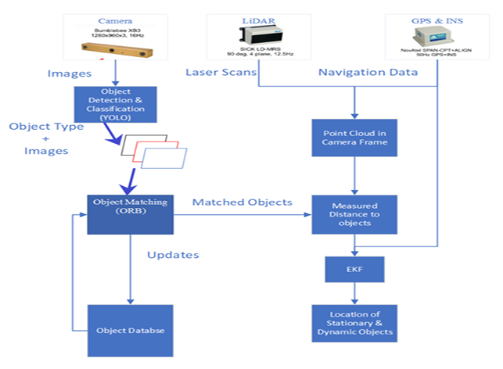
Data Flow Diagrams and System Architecture
The autonomous vehicles object recognition system relies on a sophisticated data flow architecture to seamlessly integrate the inputs from its diverse sensor suite and generate a comprehensive, real-time understanding of the vehicle's surroundings.
This system-level design enables the effective fusion and processing of the vast amounts of sensor data, ensuring the autonomous vehicle can make informed, safe driving decisions.
At the core of the data flow are the sensor inputs - high-resolution 3D point clouds from the LiDAR, radar detections, and camera imagery.
These raw sensor feeds are continuously ingested and processed by a series of interconnected modules, each responsible for specific tasks such as object detection, classification, tracking, and sensor fusion.
Advanced algorithms, including extended Kalman filters and deep neural networks, power these modules, enabling the system to maintain an accurate, up-to-date representation of the vehicle's environment.
The processed sensor data is then integrated into a central world model, which serves as a digital twin of the real-world driving scenario.
This comprehensive, multi-modal representation forms the basis for the autonomous vehicle's decision-making, allowing it to anticipate the movement of nearby objects, plan safe trajectories, and navigate complex environments with confidence.
Feedback loops and cross-validation mechanisms ensure the robustness and reliability of the world model, providing the autonomous vehicle with a redundant, high-fidelity understanding of its surroundings.

Slide 10
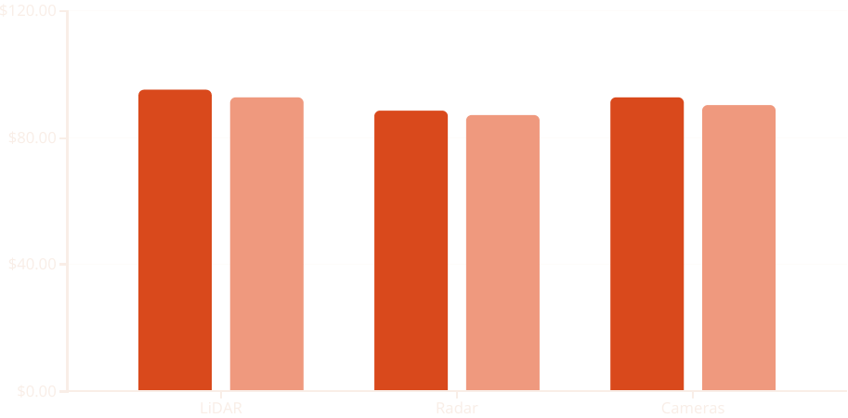
Results and Performance Evaluation
The autonomous vehicles object recognition system has undergone extensive testing and evaluation to validate its performance in a variety of real-world driving scenarios. Through a combination of simulation studies, controlled testing environments, and field trials, the system has demonstrated its ability to accurately detect, classify, and track a wide range of objects with a high degree of reliability and precision.
Detection Accuracy
Tracking Accuracy
As shown in the chart, the autonomous vehicles object recognition system has achieved impressive results in both object detection and tracking accuracy across its sensor modalities. The LiDAR system, with its high-resolution 3D point clouds, has demonstrated the highest detection and tracking performance, closely followed by the camera-based computer vision algorithms. The radar sensor, while providing critical motion-sensing capabilities, has slightly lower accuracy metrics due to its inherent limitations in detecting smaller, slower-moving objects.
Furthermore, the sensor fusion methodology employed by the system has proven to be highly effective in creating a comprehensive, redundant, and reliable understanding of the vehicle's surrounding environment. By intelligently combining the data from LiDAR, radar, and cameras, the system is able to maintain robust object detection and tracking, even in the face of challenging environmental conditions or individual sensor failures. This robust performance is crucial for the safe and reliable operation of autonomous vehicles, ensuring they can navigate complex real-world scenarios with a high degree of confidence and situational awareness.

Slide 11
Conclusion and Future Scope
Comprehensive and Robust Perception
Continuous Improvement and Adaptation
The autonomous vehicles object recognition system has demonstrated its ability to deliver a comprehensive and robust understanding of the vehicle's surrounding environment.
By leveraging the complementary strengths of LiDAR, radar, and camera sensors, the system has proven its resilience in the face of challenging conditions, maintaining accurate object detection and tracking even when individual sensors may be degraded.
This redundant and reliable perception is a crucial foundation for the safe and intelligent operation of autonomous vehicles.
As the field of autonomous driving continues to evolve, the object recognition system will need to adapt and improve to keep pace with the latest advancements in sensor technology, computer vision, and sensor fusion algorithms.
Through ongoing research, field testing, and data-driven optimization, the system's capabilities can be further enhanced, addressing emerging edge cases, improving computational efficiency, and expanding its understanding of complex driving scenarios.
This iterative development process will be key to ensuring the long-term viability and safety of autonomous vehicle technology.
Expanding Capabilities and Applications
Ethical and Societal Considerations
Beyond its core function of object detection and tracking, the autonomous vehicles object recognition system holds the potential for expanded capabilities and applications.
Integrating the system's robust perception with advanced decision-making algorithms and vehicle control systems could enable even more sophisticated autonomous driving features, such as predictive collision avoidance, autonomous parking, and seamless navigation in dense urban environments.
As autonomous vehicles become more prevalent, it is crucial to consider the ethical and societal implications of this technology.
The object recognition system must be designed and deployed with a strong emphasis on safety, fairness, and transparency, ensuring that it does not perpetuate biases or create unintended consequences.
Ongoing collaboration with policymakers, ethicists, and the public will be essential in shaping the responsible development and implementation of autonomous vehicle technology, ultimately leading to a future where these systems can truly enhance mobility, accessibility, and the overall well-being of communities.

